Slide 1
User Guide-
Parkinson’s Detection in VR
Module -

Slide 2
Learning Objectives
Integrate VR functionality into Unity using XR Rig and Main Camera.
Enable VR interaction with Canvas elements and buttons in Unity.
Implement an ONNX machine learning model for real-time VR predictions.

Slide 3
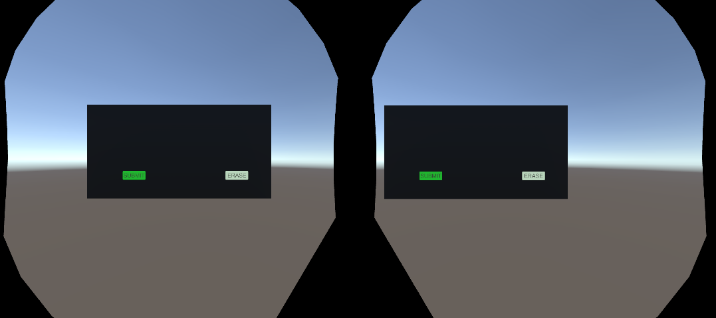
Use Case: Parkinson’s Detection in VR

Slide 4
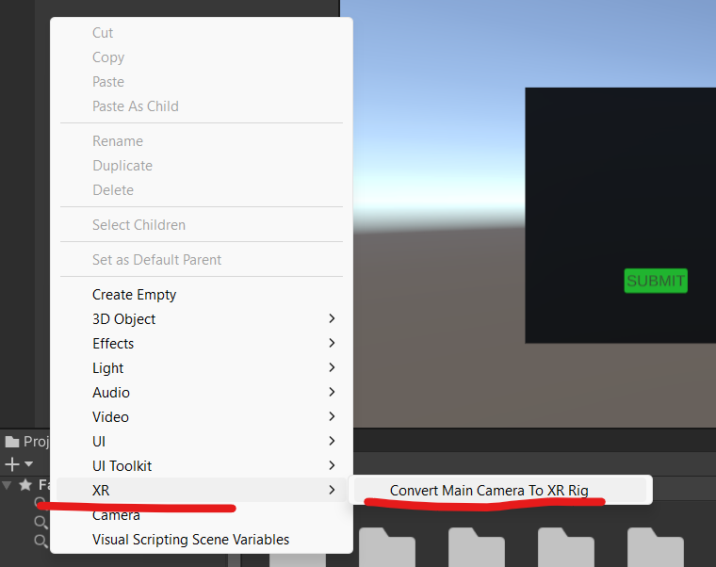
Step 1: Set Up VR Camera Rig
In Unity, go to "GameObject" in the top menu.
Choose "XR" and then select "XR Rig." This will create an XR Rig object in your scene.
The XR Rig includes the Main Camera and the VR controllers.

Slide 5
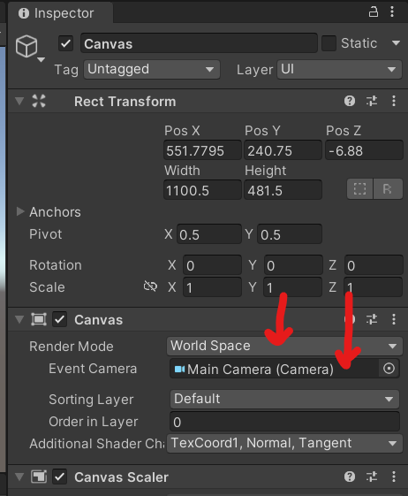
Step 2: Prepare the Canvas
Select the Canvas GameObject in your scene.
Change the "Render Mode" of the Canvas to "World Space."
In the event camera, drop your main camera :)

Slide 6
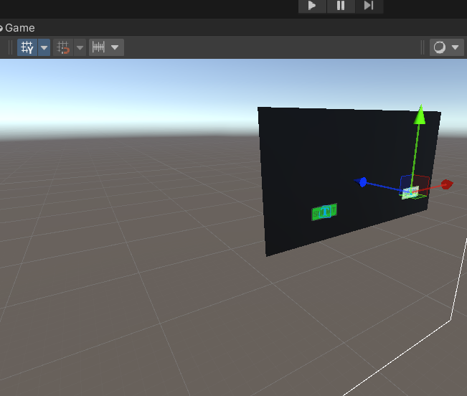
Step 2: Prepare the Canvas
Position the Canvas where you want it to appear in the VR environment.
Use Unity's Transform tools to adjust its position, rotation, and scale.
If your Canvas has buttons or other interactive elements, make sure they are child objects of the Canvas.

Slide 7
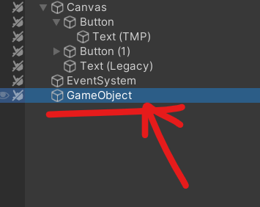
Step 3: Set Up Controller Interaction
Select the VR controller (e.g., RightHand or LeftHand) that you want to use to interact with the Canvas.
Add a new empty GameObject as a child of the VR controller.

Slide 8
Step 3: Set Up Controller Interaction
Drag the Canvas GameObject onto the empty GameObject to make it a child of the controller.
Adjust the position and rotation of the Canvas to make it comfortable and visible when the VR controller is held.

Slide 9
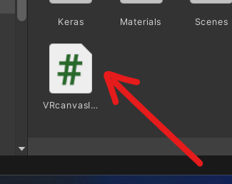
Step 4: Implement VR Button Interaction
Create a script that handles VR button interactions.
This script should be attached to the Canvas or an empty GameObject parented to the Canvas.
Notes:
using UnityEngine;
using UnityEngine.XR.Interaction.Toolkit;
using UnityEngine.UI;
public class VRCanvasInteraction : MonoBehaviour
{
[SerializeField] private XRController controller; // Reference to the VR controller that will interact with the Canvas
[SerializeField] private float activationThreshold = 0.5f; // Threshold for button press activation
private XRInteractorLineVisual lineVisual;
private bool isInteracting = false;
private Selectable currentButton; // Reference to the currently selected button
private void Start()
{
lineVisual = controller.GetComponent<XRInteractorLineVisual>();
}
private void Update()
{
if (lineVisual != null)
{
if (lineVisual.GetCurrentLineSegment().distance < activationThreshold)
{
if (!isInteracting)
{
isInteracting = true;
HandleButtonInteraction();
}
}
else
{
isInteracting = false;
}
}
}
private void HandleButtonInteraction()
{
if (currentButton == null)
return;
currentButton.OnPointerClick(null); // Simulate a pointer click on the button
// You can add more logic here based on the button's interaction, like calling the ONNX model for predictions.
}
public void SetCurrentButton(Selectable button)
{
currentButton = button;
}
}

Slide 10
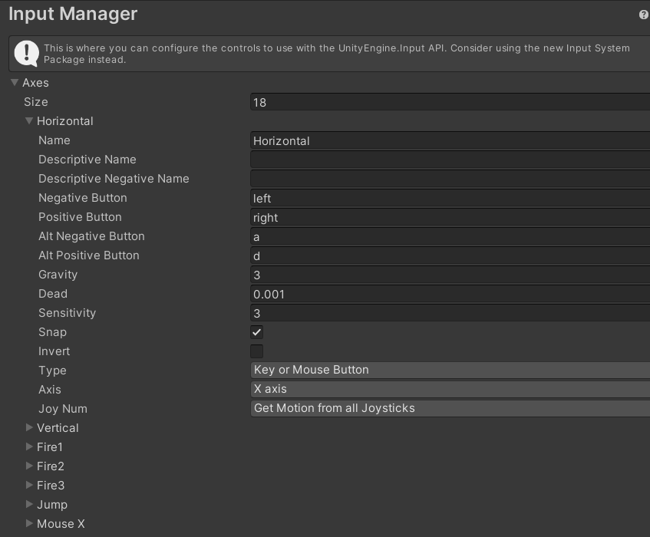
Step 4: Implement VR Button Interaction
Use the appropriate input events for VR controllers, such as "Trigger Press" or "Button Press," to detect when the user interacts with the buttons.
Implement the logic to respond to the button interactions accordingly, such as triggering the spiral drawing or other actions based on the ONNX model.

Slide 11
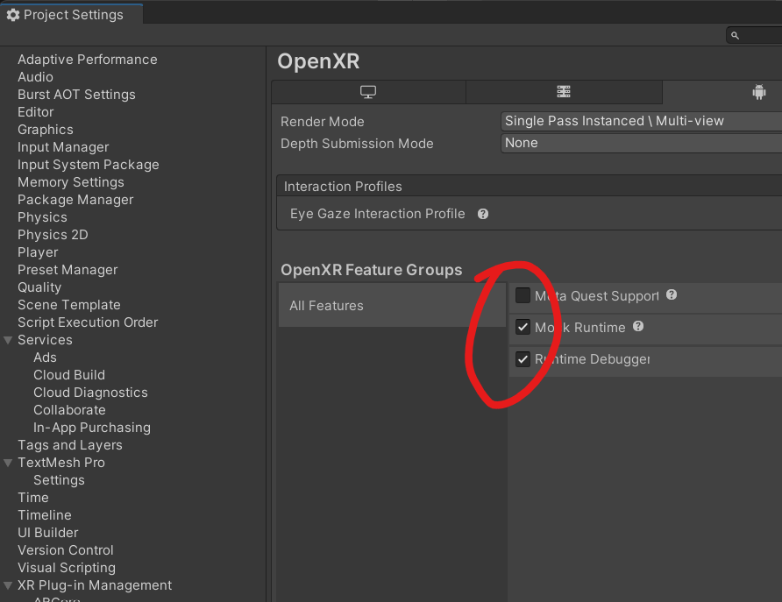
Step 5: Test and Optimize
Build your project for the VR platform you are targeting (e.g., Oculus Rift, HTC Vive, etc.).
Deploy the build to your VR device or use the VR simulator within Unity to test the project.

Slide 12
Step 5: Test and Optimize
Test the Canvas interaction, spiral drawing, and the ONNX model's response in the VR environment.
Make any necessary adjustments to ensure a comfortable and user-friendly experience.
Consider factors like the Canvas size, button size, and the ease of interaction with the VR controllers.

Slide 13
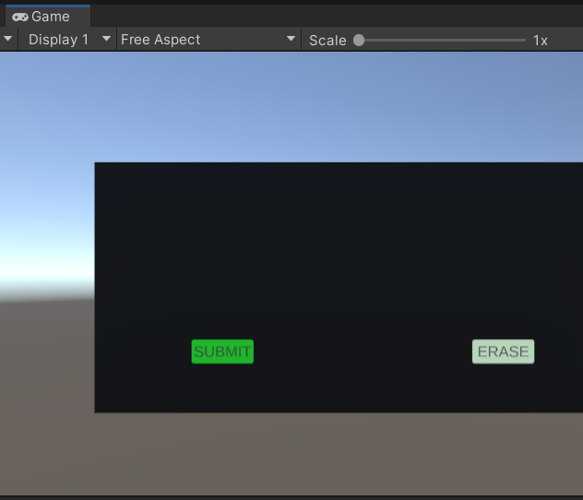
Step 6: Handling VR Input in Your ONNX Model
Ensure that your ONNX model can handle VR input. If it relies on mouse input, you may need to modify it to work with VR controllers or hand tracking.

Slide 14
Working project in VR

